Slide 1

Transformer and Pre-Trained Language Models

Slide 2
Contents
Introduction to Transformer
Motivation for Transformer
Transformer Architecture
Self-Attention Mechanism
Positional Encoding
Pre-Trained Language Models

Slide 3
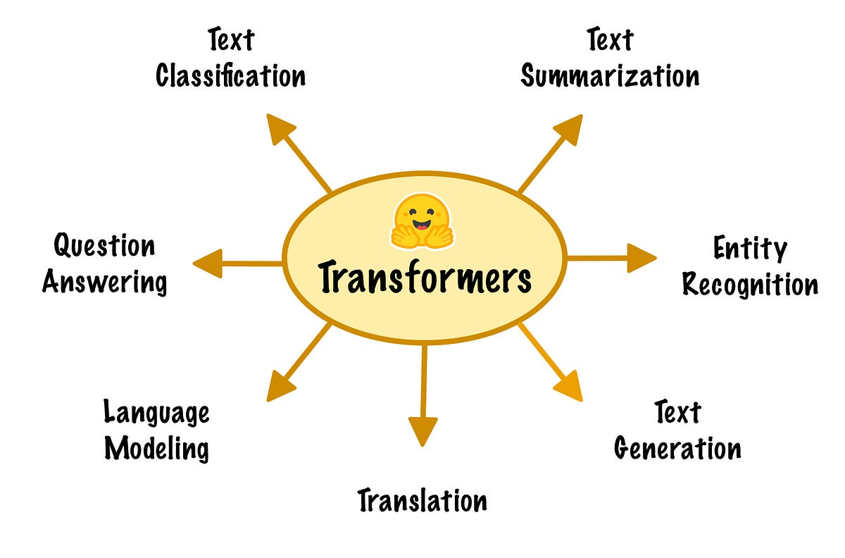
Introduction to Transformers
Transformers in Natural Language Processing (NLP)
  Transformers represent a revolutionary architecture in the field of Natural Language Processing (NLP) that has transformed how we process, understand, and generate human language.
  They have significantly advanced the state-of-the-art in various NLP tasks, from machine translation to text generation and sentiment analysis.

Slide 4
Introduction to Transformers
Handling Sequential Data without Recurrence or Convolution
  Unlike earlier models that relied on recurrent neural networks (RNNs) for sequential data or convolutional neural networks (CNNs) for image data, Transformers introduced a paradigm shift in how sequential data, such as text, is processed.
  Transformers utilize a mechanism called self-attention, which allows them to capture relationships between words in a sentence regardless of their distance from each other.
  This self-attention mechanism makes Transformers inherently parallelizable and efficient, avoiding the sequential processing limitations of RNNs.

Slide 5
Introduction to Transformers
Breakthrough Role in NLP Tasks
  Machine Translation
    Transformers, especially models like "Transformer" and "BERT," have greatly improved machine translation by capturing context and relationships between words more effectively.
  Text Generation
    Transformers have been used to generate coherent and contextually relevant text, producing impressive results in areas like story generation and content summarization.
  Question Answering
    Models like BERT have excelled in question-answering tasks by understanding context and providing accurate answers based on given questions and passages.
  Sentiment Analysis
    Transformers have improved sentiment analysis by considering the overall context and nuances of language, resulting in more accurate sentiment classification.
  Named Entity Recognition
    They have demonstrated remarkable performance in identifying named entities (e.g., names, locations) within text.
  Document Classification
    Transformers have been used for classifying entire documents into categories, enhancing the understanding of document content.

Slide 6
Motivation for Transformer
Limitations of RNNs and CNNs
  Recurrent Neural Networks (RNNs) and Convolutional Neural Networks (CNNs) have been foundational in various machine learning tasks, but they come with limitations, particularly in handling sequential data like language.
  RNNs
    While RNNs can capture sequential dependencies, they suffer from vanishing and exploding gradient problems.
    These issues hinder their ability to effectively learn long-range dependencies in sequences.
  CNNs
    Convolutional Neural Networks are highly efficient for image data due to their ability to capture local patterns, but they are less effective in capturing long-range dependencies in sequences, like sentences.

Slide 7
Motivation for Transformer
Combining Attention Mechanisms and Parallel Processing
  The limitations of RNNs and CNNs prompted the development of the Transformer architecture.
  Transformers use self-attention mechanisms to address the challenges of capturing long-range dependencies while enabling parallel processing.
  Attention Mechanism
    The attention mechanism allows each word to consider the importance of other words in the sequence, creating contextual relationships. It overcomes the limitations of fixed-size context windows in RNNs and the local receptive fields in CNNs.
  Parallel Processing
    Transformers' self-attention mechanism is inherently parallelizable. Unlike RNNs that process sequences sequentially, Transformers can process all words in parallel, making them highly efficient and suitable for modern hardware architectures.

Slide 8
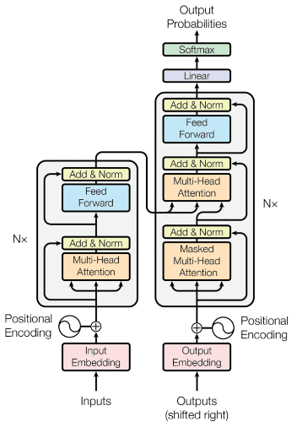
Transformer Architecture
The architecture is based on self-attention mechanisms and feedforward neural networks.

Slide 9
Transformer Architecture
Self-Attention Mechanism
  The self-attention mechanism is a key component of Transformers that allows a word to consider the importance of other words in the same sequence. It captures relationships between words regardless of their distance.
Feedforward Neural Networks
  After self-attention, a feedforward neural network is applied to each word's contextual representation. This network consists of fully connected layers and non-linear activation functions.

Slide 10
Transformer Architecture
Encoder and Decode
Encoder
    The encoder stack consists of multiple layers of self-attention mechanisms followed by feedforward neural networks. Each layer refines the representation of words based on context and relationships with other words in the sequence.
Decoder
    The decoder stack mirrors the encoder but also includes an additional attention mechanism that focuses on the encoder's output. This enables the decoder to generate output sequences, making the Transformer architecture suitable for tasks like machine translation and text generation.

Slide 11
Transformer Architecture
Positional Encodings
  Since Transformers don't have inherent positional information like RNNs, positional encodings are added to input embeddings to convey word order.
Multiple Heads
  In practice, the self-attention mechanism often uses multiple attention "heads" to capture different types of relationships within a sequence.

Slide 12
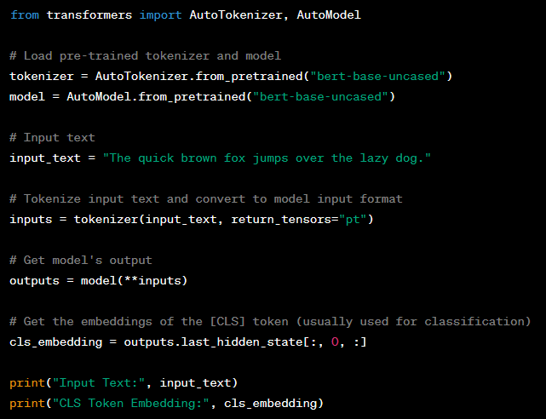
Example
example of a Transformer architecture using the Hugging Face Transformers library, which is a popular library for working with transformer models
In this example:
We use the Hugging Face Transformers library to load a pre-trained tokenizer (bert-base-uncased) and model (bert-base-uncased).
We tokenize an input text and convert it to the format expected by the transformer model.
We pass the tokenized input to the model and obtain the model's output, which includes embeddings for each token.
We extract the embedding of the [CLS] token, which is commonly used as the representation for downstream tasks.

Slide 13
Self-Attention Mechanism
Calculating Attention Scores and Weighted Context Vectors
  Query, Key, Value
    Each word in the sequence is transformed into three vectors: Query, Key, and Value. These vectors are derived from the original word embeddings.
  Attention Scores
    For each Query, attention scores are calculated by taking the dot product (or using other similarity measures) between the Query vector and all Key vectors. These scores reflect how much attention the Query word should assign to each Key word.
  Applying Softmax
    The attention scores are then passed through a softmax function to ensure that the scores sum up to 1. This step essentially determines the importance weights for each Key.
  Weighted Context Vectors
    The attention scores are used to compute a weighted sum of the Value vectors. This weighted sum represents the contextual information that the Query word derives from other words in the sequence. It captures how much emphasis each neighbor contributes to the Query's understanding.

Slide 14
Self-Attention Mechanism
Capturing Local and Global Dependencies
  Self-attention captures both local and global dependencies in a sequence
  Local Dependencies
    Nearby words have high attention scores, allowing each word to consider its neighboring words and their meanings. This enables the model to understand local word relationships and grammatical structures.
  Global Dependencies
    Words that are farther apart can still have significant attention scores if they contribute to understanding the context. This enables the model to capture long-range dependencies and nuanced semantic relationships between distant words.

Slide 15
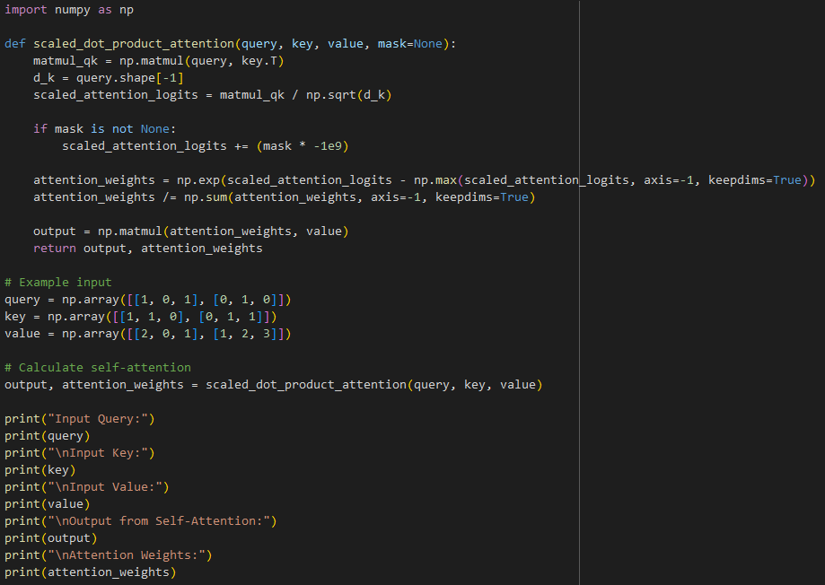
Self-Attention Mechanism
Example
In this example:
We define a custom PositionalEncoding module that calculates the positional encoding for input sequences.
The get_positional_encoding method generates the positional encoding matrix for a given sequence length and embedding size.
The forward method adds the positional encoding to the input data.
We provide example input for sequence_length, embedding_size, and batch_size.
The output shape of the positional encoding is printed.

Slide 16
Positional Encoding
Concept
  Positional encodings are introduced in the Transformer architecture to address the absence of positional information in the model's initial input.
  They inject information about the position of words into the word embeddings, allowing the model to differentiate words based on their positions within the sequence.

Slide 17
Positional Encoding
Injecting Order Information
  Encoding Scheme
    Positional encodings are generated based on a predefined scheme, often using trigonometric functions. These encodings are designed to have distinct patterns for different positions.
  Adding to Word Embeddings
    The positional encodings are added element-wise to the word embeddings. This addition introduces a unique pattern for each position that the model can learn from.

Slide 18
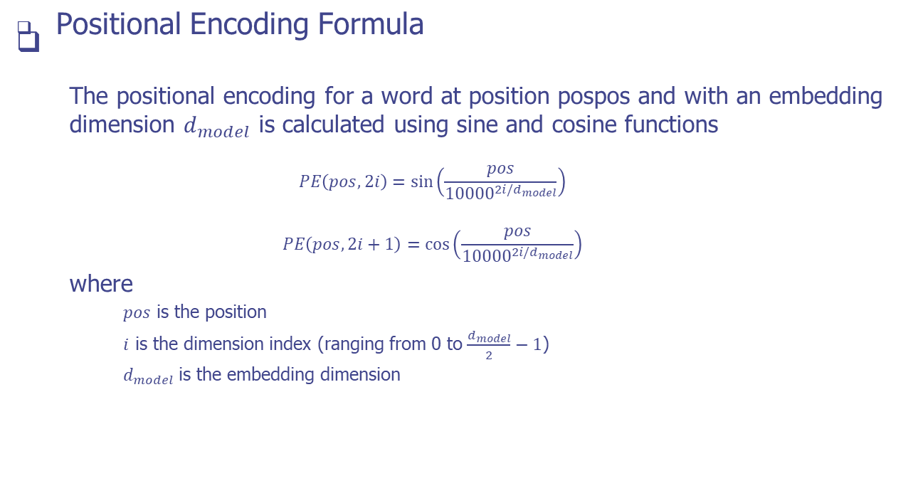
Positional Encoding

Slide 19
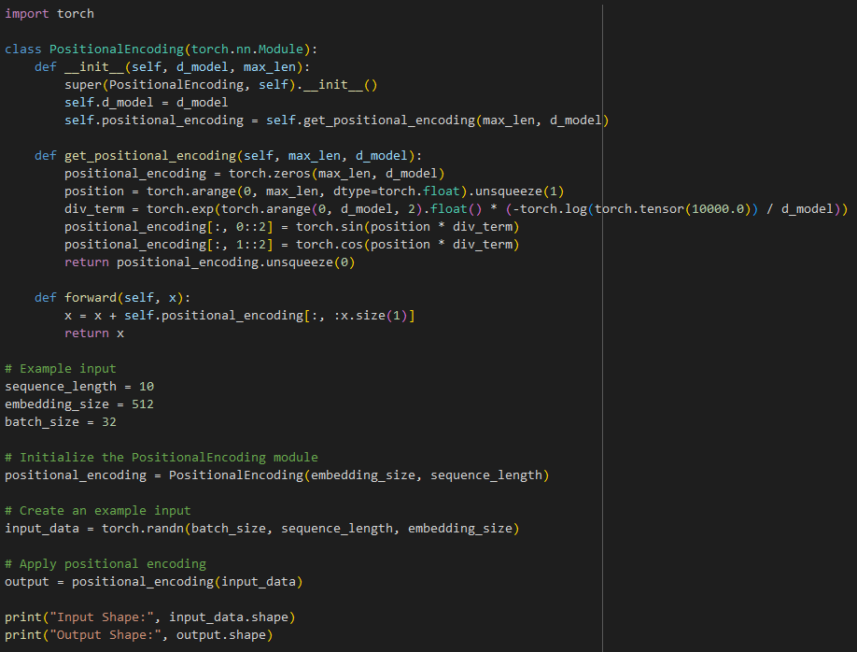
Positional Encoding
Example
In this example:
We define the scaled_dot_product_attention function that implements the self-attention mechanism. It takes query, key, and value matrices as input and an optional mask for masking certain positions.
We calculate the scaled dot product of query and key, and then apply the scaled softmax to obtain attention weights.
We multiply the attention weights with the value matrix to get the output of the self-attention mechanism.
We provide an example input for query, key, and value matrices.
The output and attention weights are printed to demonstrate the result of the self-attention mechanism.

Slide 20
Pre-Trained Language Models
Pre-trained language models are neural network models that are trained on massive amounts of text data from diverse sources before being fine-tuned for specific downstream tasks.
During pre-training, these models learn to generate contextual word representations that capture the meaning and relationships of words within their surrounding context.

Slide 21
Pre-Trained Language Models
Capturing Semantic Meanings and Relationships.
  Pre-trained models learn to encode words in a way that captures not only their individual meanings but also the nuances of how they relate to other words in various contexts.
  This contextual understanding enables them to grasp semantic relationships, synonyms, antonyms, analogies, and other linguistic intricacies.

Slide 22
Pre-Trained Language Models
Emergence of BERT, GPT-3, and Advanced Models.
  BERT (Bidirectional Encoder Representations from Transformers)
    BERT was a breakthrough pre-trained model introduced by Google. It demonstrated remarkable contextual understanding by training on both left and right context in sentences. BERT's bidirectional nature helped it capture broader contextual information, leading to significant improvements in various NLP tasks.
  GPT-3 (Generative Pre-trained Transformer 3)
    Developed by OpenAI, GPT-3 took pre-trained models to another level with its massive scale—175 billion parameters. GPT-3 is known for its ability to generate coherent and contextually relevant text. It can perform tasks ranging from text completion to translation without fine-tuning.

Slide 23
Pre-Trained Language Models
Emergence of BERT, GPT-3, and Advanced Models.
  XLNet, T5, RoBERTa, etc.:
    The success of BERT and GPT-3 sparked the development of various advanced models. XLNet introduced a permutation-based training approach, T5 focused on text-to-text tasks, and RoBERTa optimized BERT's training methodology. These models pushed the boundaries of what pre-trained language models could achieve.
  Task-Specific Fine-Tuning
    While pre-trained models like BERT and GPT-3 offer powerful contextual representations, they are often fine-tuned for specific tasks to enhance their performance on those tasks. This fine-tuning stage adapts the general language understanding to the specifics of the target task.

Slide 24
Practice
Instructions
  In this assignment, you'll explore and analyze the inner workings of a Transformer architecture and work with more advanced aspects of pre-trained language models.
Tasks
  Task 1: Transformer Components
    Implement a self-attention mechanism from scratch using NumPy.
    Explain the purpose of multi-head attention and how it improves the attention mechanism in Transformers.
  Task 2: Pre-Training and Fine-Tuning
    Choose a pre-trained language model (e.g., GPT-2) and load it using the Hugging Face Transformers library.
    Explain the concepts of pre-training and fine-tuning in the context of language models.
  Task 3: Text Generation
    Use the loaded pre-trained language model to generate creative text.
    Implement a temperature parameter to control the randomness of generated text.

Slide 25
Q & A

